Slide 1
CSE 12 – Basic Data Structures and Object-Oriented Design Lecture 8
Greg Miranda & Paul Cao, Winter 2021
This lecture is being recorded

Slide 2

Announcements
Quiz 8 due Monday @ 8am
Survey 3 due tonight @ 11:59pm
PA3 due Wednesday @ 11:59pm
Exam 1 next Friday
Released @ 8am on Friday
Closes @ 10am on Saturday
More details to be released on Piazza soon

Slide 3
Topics
Questions on Lecture 8?
BFS/DFS

Slide 4
Questions on Lecture 8?

Slide 5
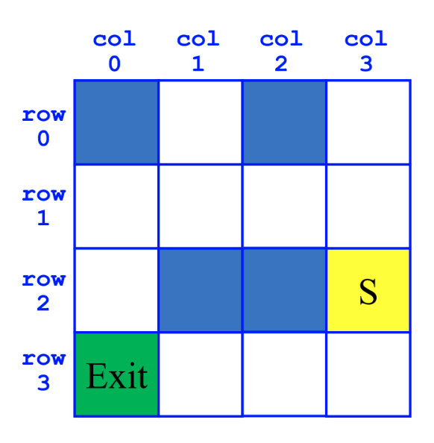
Breadth-First Search (BFS)
SearchForTheExit
Initialize a Queue to hold Squares as we search
Mark starting square as visited
Enqueue starting square on Queue
While Queue is not empty
Dequeue square sq from Queue
Mark sq as visited
If sq is the Exit, we're done!
For each of square's unvisited neighbors (S, W, N, E):
Set neighbor's previous to sq
Enqueue neighbor to Queue

Slide 6
Depth-First Search (DFS)
SearchForTheExit
Initialize a Stack to hold Squares as we search
Mark starting square as visited
Push starting square on Stack
While Stack is not empty
Pop square sq from Stack
Mark sq as visited
If sq is the Exit, we're done!
For each of square's unvisited neighbors (S, W, N, E):
Set neighbor's previous to sq
Push neighbor to Stack

